Slide 1
G2M Cab Case Study
Matthew Zhou
April 13, 2023

Slide 2

Background
XYZ is a private firm in the US that, due to the remarkable growth in the Cab industry in the last few years, plans to invest in the Cab industry.
Goal: Provide actionable insights to help XYZ identify the right company to make their investment

Slide 3
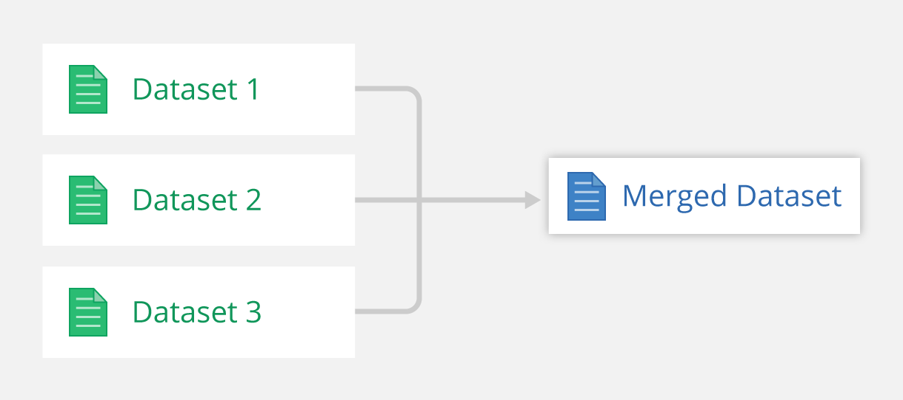
Data Exploration
Timeframe – 02/01/2016 – 31/12/2018
Cab Data, Customer ID, Transaction ID merged into one Data frame
359392 Datapoints – 12 total features
Cab Data shares TransactionID feature with Transaction ID, TransactionID shares CustomerID feature with CustomerID
Cab Data
Customer
Transaction

Slide 4
Data Exploration
274681 Yellow Cab Datapoints, 84711 Pink Cab Datapoints
12 Features – 7 from Cab Data, 3 from Customer ID, 2 from Transaction ID
Transaction ID (int), Date of Travel (int), Company (categorical), City (categorical), KM Travelled (float), Price Charged (float), Cost of Trip (float), Customer ID (int), Payment Mode (categorical), Gender (categorical), Age (int), Income (int)
Added 5 features – Year, Month, Date, Weekday, Profit (Price Charged – Cost of Trip)
City Dataset – 20 Datapoints – 3 features
City (categorical), Population (int), Users(int)
No missing or NaN datapoints

Slide 5
Profit Analysis
Cab | Total Profit | # of Rides | Profit/Ride | Profit/KM
Yellow | 44020373.17 | 274681 | 160.26 | 7.11
Pink | 5307328 | 84711 | 62.65 | 2.77

Slide 6
Customer Base
Yellow customers: 39896, Pink customers: 32330

Slide 7
Customer Retention
Company | >=10 rides | >=20 rides
Yellow | 10715 (26.85%) | 3552 (8.90%)
Pink | 492 (1.52%) | 0 (0%)
Yellow is more likely to be a better investment because it retains a significantly larger proportion of its customer base. We can see from the previous slide that the demographics of the customer base for both Yellow and Pink are very similar, and the number of unique customers is only off by a factor of 23.4%, but the Yellow retains more 20x the customers.

Slide 8
Seasonality
There is a clear relationship between season and the demand for cab rides. During the Winter, the demand is higher, and especially during Christmas season, demand for cab rides is the highest. During the Spring and Summer, demand is lower. There is not a real clear relationship between demand and the day of the month.

Slide 9
Seasonality
The demand for cabs is the highest during the weekends, with Friday being the highest demanding day out of the week for both Yellow and Pink. The demand is lowest during weekdays, especially Monday.

Slide 10
City Presence
Both Yellow and Pink have a similar number of users of their cab services for most cities. In certain cities such as Atlanta and Dallas, Yellow has a much higher presence than Pink. However, there are also cities such as San Diego and Nashville where Pink has a slightly larger presence. The most telling sign is that in cities such as New York and Chicago, where both Yellow and Pink have similar number of users, Yellow has significantly more rides than Pink and significantly more KM travelled.

Slide 11
Conclusion
From the various analyses of the data, we recommend investing in Yellow.
Total # of Rides & Profit – Over the three years of data, Yellow has always had significantly more rides and more profit. While it seems that Yellow is declining in the last year, Pink is seeing a decline in rides and profit as well in the last year.
Customer Base – Both Yellow and Pink have around the same number of unique users. This indicates that Pink’s lack of success is not due to a lack of advertising or reach. Users have tried both services and returned to using Yellow for their cab. This is seen in the Customer Retention scores.
Customer Demographics – Both Yellow and Pink appeal to different Age, Gender, and Income brackets at the same proportional amounts. Yellow has more customers in every demographic.
Seasonality – Both Yellow and Pink are affected by the same seasonal trends, with demand increasing during the Winter and Christmas, and demand increasing during weekdays.
City Presence – Yellow has a larger presence in 15 out of the 20 cities. In cities where Yellow and Pink have comparable presence, Yellow is far more popular as seen by the significantly higher number of rides and kilometers travelled.

